Slide 1
Master Thesis
Images for Thesis and presentation

Slide 2



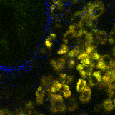
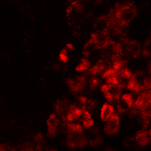

Napari
Point cloud
Labeling with points in 3D
Training data
Density maps for multiple cell classes
U-net
Stack
NADH
Cell Number
Threshold + Object counting

